Slide 1






Heart Attack
Prediction
By group 2 - SE1840
Lecturer: HuongNTD13

Slide 2

Team members
Nguyễn Tuấn Kiệt - SE183979
Lê Thanh Hùng - SE181763
Thái MInh Tuấn - SE181850
Nguyễn Ngọc Long - SE193490
Trần Duy Đạt - SE190622
Trần Tuấn Kiệt - SE194431
Phạm Vũ Khánh Như - SE194657

Slide 3
Contents
Reason for choosing the topic
Data visualization
Theoretical concepts and formulas
Code
Results
Conclusion

Slide 4
Reason for choosing the topic
Objective: Predict the risk of heart attacks based on health and lifestyle factors using logistic regression.
Methodology: Analyzed real-world patient data and applied both univariate and multivariate logistic regression to identify significant predictors.
Results: Identified key risk factors that can help in early detection, prevention, and effective intervention for heart disease.
Applications: Support early diagnosis, guide preventive measures, and develop personalized treatment strategies based on data-driven insights.

Slide 5
2. Data visualization

Slide 6
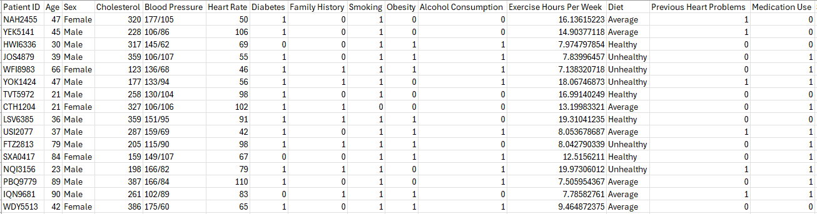
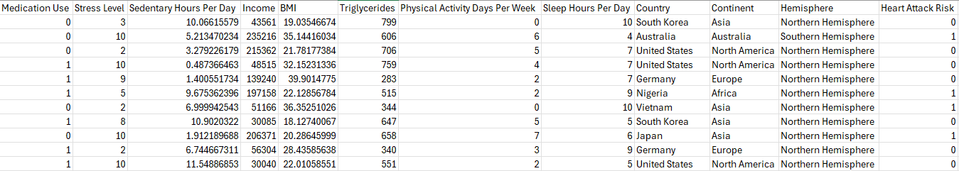
2.1 Data Overview

Slide 7
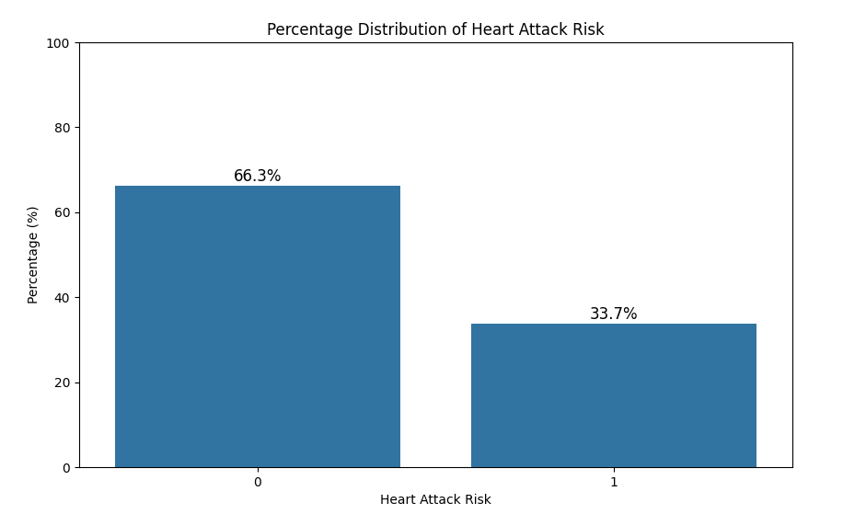

Slide 8
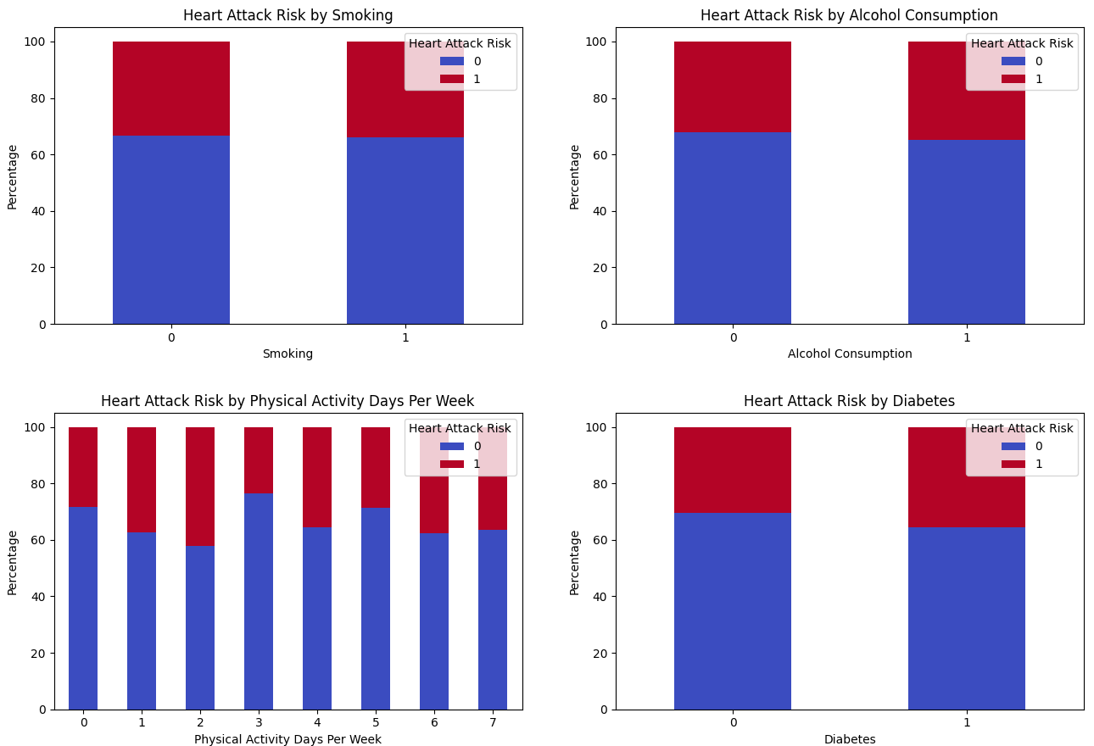

Slide 9
3. Theoretical concepts and formulas
This project involves predicting the risk of a heart attack using Logistic regression.

Slide 10
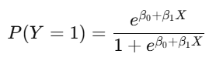
3. Theoretical concepts and formulas
Univariate Logistic Regression
Purpose: To identify statistically significant variables (with p-value < 0.05) that influence the target variable (Heart Attack Risk).
Formula:
Where:
P(Y=1) is the probability of the outcome being 1.
e is Euler’s number (~2.718).
β0​: Intercept.
β1​: Coefficient of the independent variable X.

Slide 11
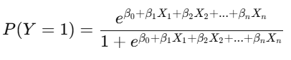
3. Theoretical concepts and formulas
Multivariate Logistic Regression
Purpose: To model the relationship between multiple independent variables and the target variable.
Formula:
Where:
P(Y=1) is the probability of the outcome being 1.
e is Euler’s number (~2.718).
β0 is the intercept.
β1,β2,...,βn are the regression coefficients for the independent variables X1,X2,...,Xn

Slide 12
3. Theoretical concepts and formulas
Multivariate Logistic Regression
Purpose: To model the relationship between multiple independent variables and the target variable.
Formula:
Threshold = 0.3:
Predict class 1 if P(Y=1) ≥ 0.3.
Predict class 0 if P(Y=1) < 0.3.

Slide 13
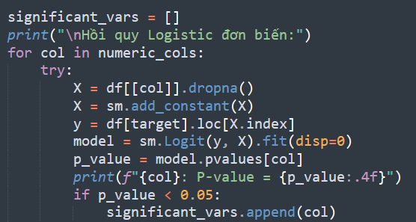
4. Code
Simple Logistic Regression

Slide 14
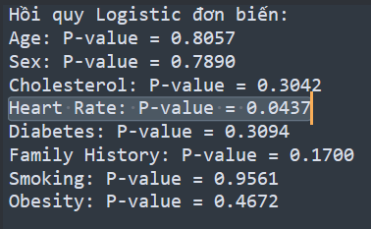
4. Code
Simple Logistic Regression

Slide 15
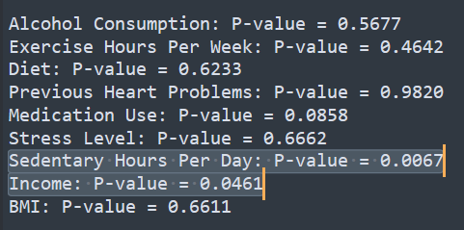
4. Code
Simple Logistic Regression

Slide 16
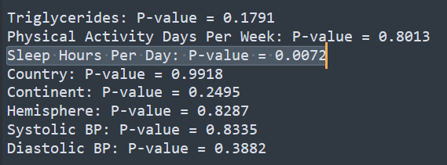
4. Code
Simple Logistic Regression

Slide 17
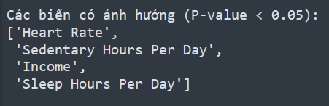
4. Code
Simple Logistic Regression

Slide 18
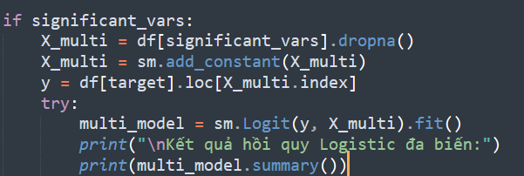
4. Code
Multiple Logistic Regression

Slide 19
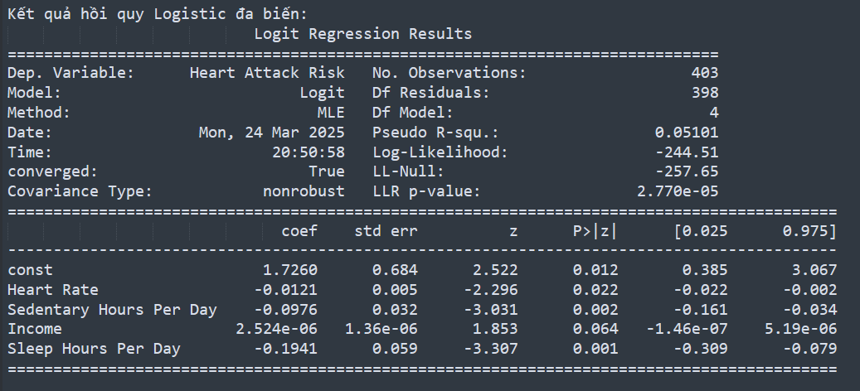
4. Code
Multiple Logistic Regression

Slide 20
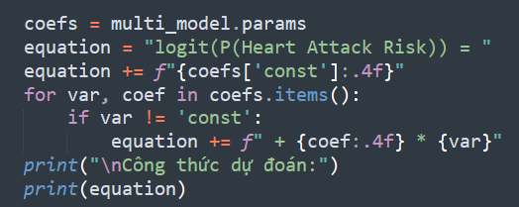
4. Code
Multiple Logistic Regression
Công thức dự đoán:
logit(P(Heart Attack Risk)) = 1.7260 + -0.0121 * Heart Rate + -0.0976 * Sedentary Hours Per Day + -0.1941 * Sleep Hours Per Day

Slide 21
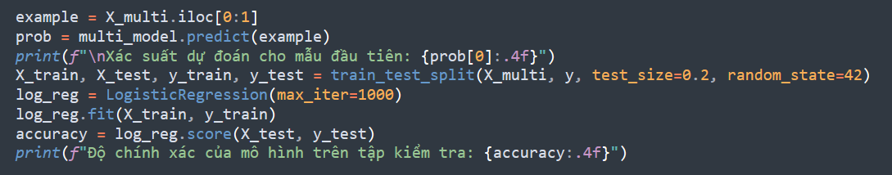
4. Code
Multiple Logistic Regression
Xác suất dự đoán cho mẫu đầu tiên: 0.2002
Độ chính xác của mô hình trên tập kiểm tra: 0.6790

Slide 22
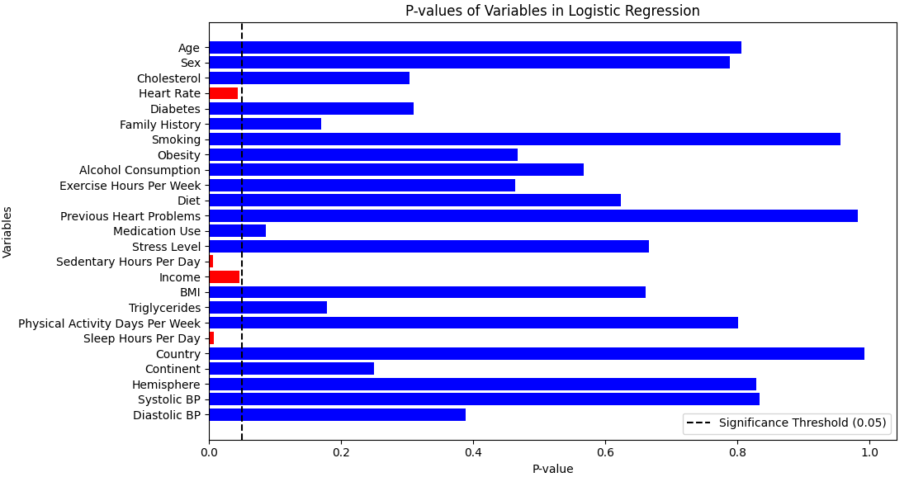
4. 2 Charts

Slide 23
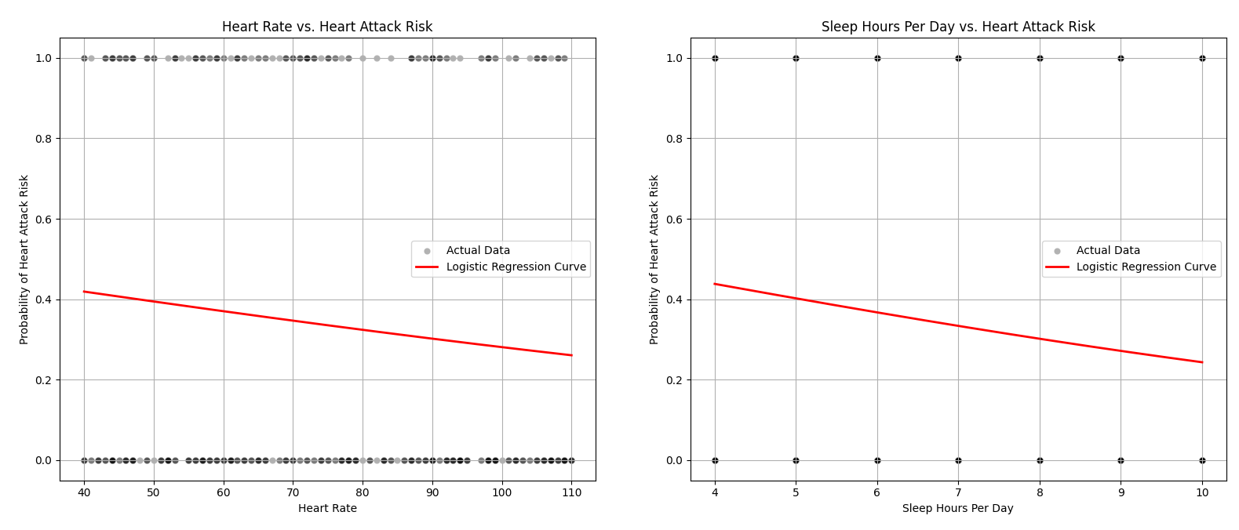
4. 2 Charts

Slide 24
5.Result

Slide 25
Univariate Logistic Regression identified 4 significant factors affecting heart attack risk:
Heart Rate (p = 0.0437), Sedentary Hours Per Day (p = 0.0067), Income
(p = 0.0461), and Sleep Hours Per Day (p = 0.0072).
Multivariate Logistic Regression confirmed that:
-Heart Rate(P=0.022)
-Sedentary Hours Per Day(p=0.002)
-Sleep Hours Per Day(p=0.001) remained significant
while Income (p = 0.064) was no longer statistically important.
Model accuracy on test data: 67.90%
logit(P(Heart Attack Risk)) = 1.7260 + -0.0121 * Heart Rate + -0.0976 * Sedentary Hours Per Day + -0.1941 * Sleep Hours Per Day

Slide 26
6. Conclusion

Slide 27
This project focus on predicting the risk of heart disease using Logistic regression models. Univariate and multivariate analyses revealed that the variables that significantly influenced the risk of heart disease included: Heart Rate, Sedentary Hours Per Day, Income, and Sleep Hours Per Day. Of these, Sleep Hours Per Day and Sedentary Hours Per Day had the strongest impact.
The model accuracy of 67.90% means that the logistic regression model correctly predicts about 67.90% of the cases in the test set. This is an average level of accuracy, showing that the model performs better than random guessing (50%). However, it is not reliable enough for real medical applications.

Slide 28
Q&A SESSION

Slide 29
Thank
You

